Slide 1

IST 659
Final PROJECT
RECIPE MANAGEMENT SYSTEM
Prof. Jillian Lando

Slide 2

01.
INTRODUCTION

Slide 3

PROJECT OVERVIEW
The Recipe Management System is a comprehensive database and application designed to organize and manage a vast collection of recipes.
This system allows users to explore, create, and share their favorite recipes, fostering a community of culinary enthusiasts.
The system is equipped with robust relational database capabilities, ensuring data integrity and efficient retrieval.
The Recipe Management System provides a centralized platform for culinary enthusiasts to share, explore, and appreciate the art of cooking.
Whether you're a seasoned chef or an aspiring home cook, this system aims to enhance your culinary journey and create a vibrant community of food lovers.

Slide 4

Problem Statement
Recipe Disarray
Recipes are scattered across various platforms, notebooks, or digital documents, leading to disorganization and inefficiency.
Collaborative Cooking
Cooking enthusiasts, both novice and seasoned, lack a common platform to share and discover recipes, tips, and experiences.
Ingredient Inventory
There is a need for a system that not only stores recipes but also helps users manage their ingredient inventory efficiently.
Rating and Feedback
Without a dedicated system for rating and feedback, users struggle to discern the most well-received recipes.

Slide 5
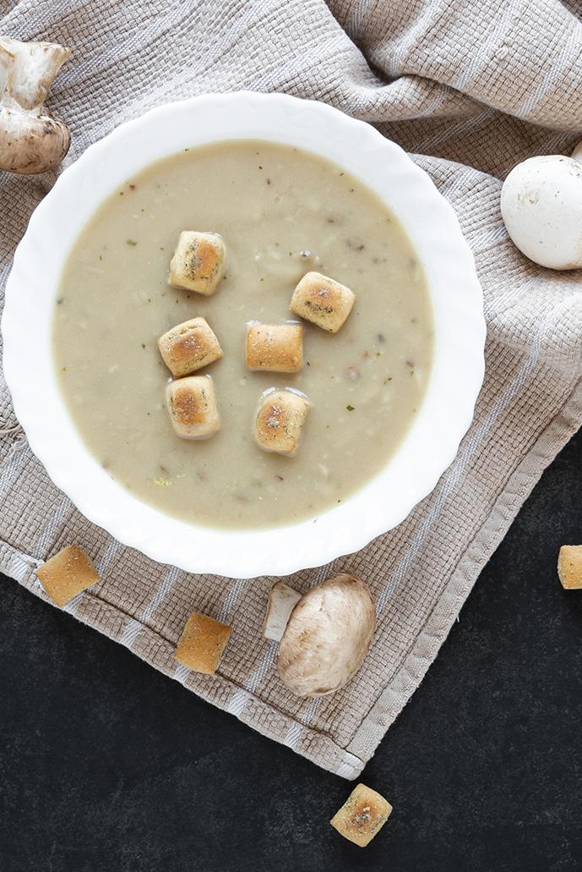
PROPOSED SOLUTION
Ingredient Inventory Management
Centralized Recipe Repository
Establish a centralized database for users to store, organize, and retrieve their diverse recipe collections.
Provide tools for users to manage their ingredient inventory, offering insights into available ingredients, their quantities, and potential recipes based on existing supplies.
Collaborative Features
Rating and Feedback System
Facilitate collaboration by allowing users to share recipes, tips, and experiences within the platform.
Implement a standardized rating and feedback system to enable users to evaluate and share their experiences with recipes.

Slide 6

02.
ER Data REQUIREMENTS

Slide 7

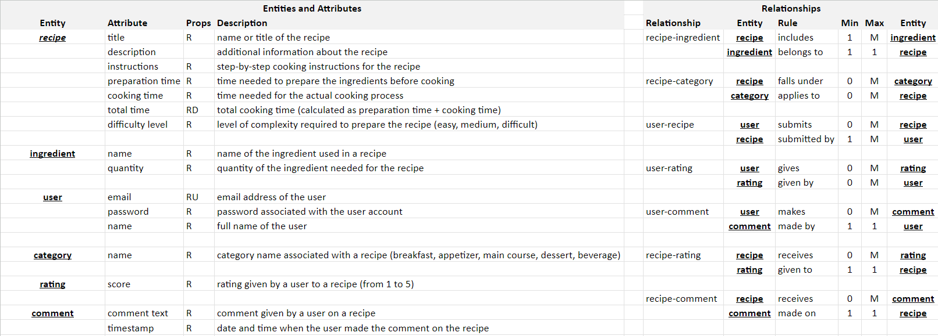

Slide 8

03.
Conceptual Data Model

Slide 9
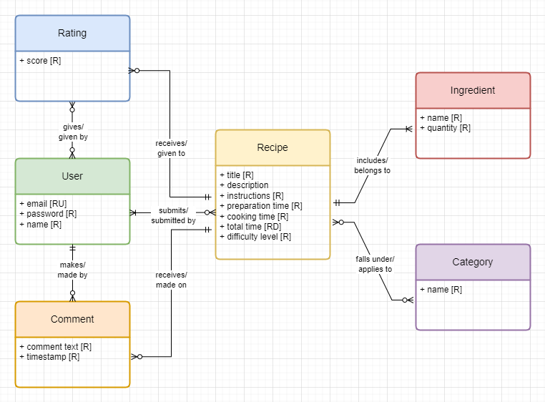

Slide 10

04.
Logical Data Model

Slide 11
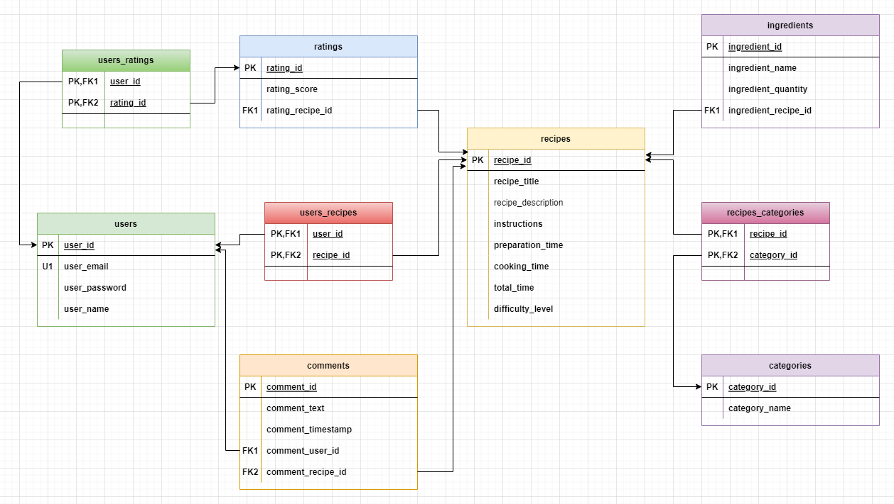

Slide 12

05.
IMPLEMENTATION

Slide 13
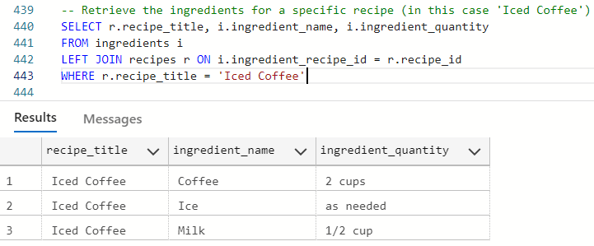
Notes:
when you want to display all the ingredients and their quantities for a specific recipe, in this case, ‘Iced Coffee’

Slide 14
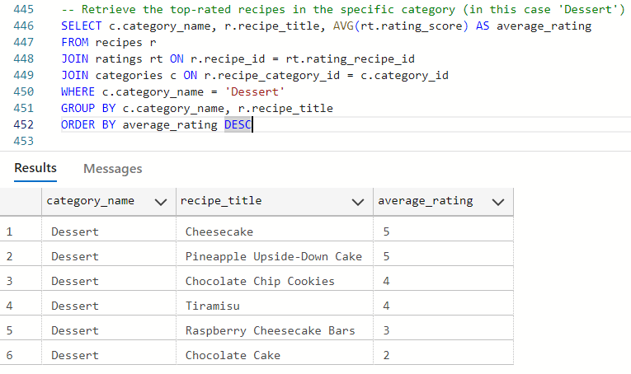
Notes:
showcasing the highest-rated recipes within a specific category, helping users find the most popular dessert recipes

Slide 15
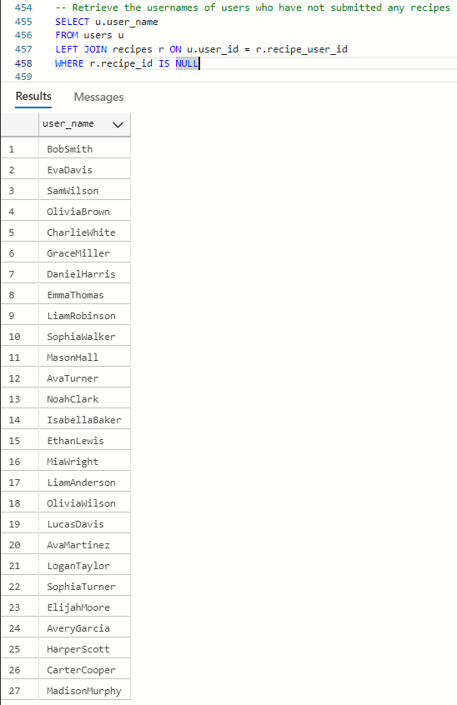
Notes:
identifying users who have not contributed any recipes, which could be valuable for engagement or outreach strategies

Slide 16
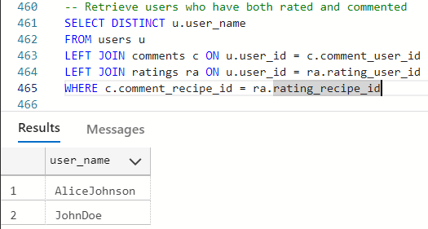
Notes:
find users who actively engage with recipes by both rating and commenting, which might be useful for community building or targeted interactions

Slide 17
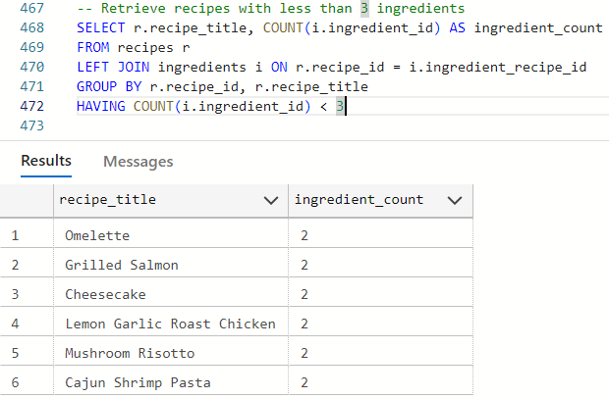
Notes:
users looking for simple recipes, as it filters and displays recipes with fewer than three ingredients

Slide 18
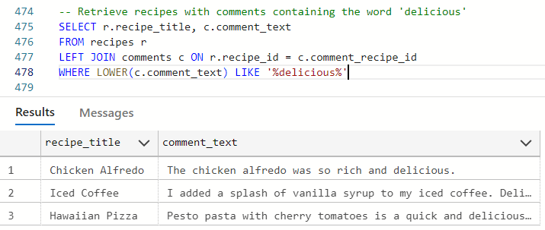
Notes:
find recipes that have received positive comments containing the word 'delicious,' helping to highlight well-received recipes

Slide 19
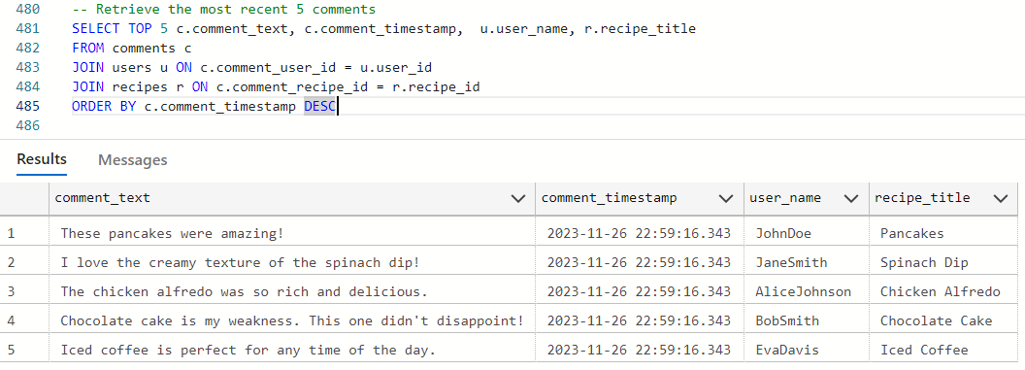
Notes:
most recent user comments, which can be displayed on a website or app to keep users informed about recent interactions and discussions

Slide 20
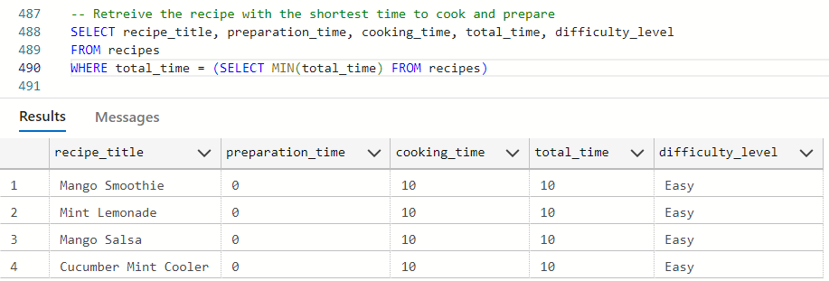
Notes:
users looking for quick recipes by identifying the recipe with the shortest total preparation and cooking time

Slide 21

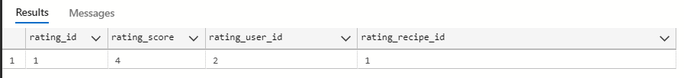
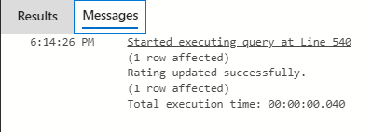
Stored procedure to check whether the provided rating score is valid (between 1 and 5) and then either updates an existing rating or inserts a new one
-- Valid rating
EXEC sp_add_or_update_rating @UserID = 2, @RecipeID = 1, @RatingScore = 4
SELECT * FROM ratings WHERE rating_user_id = 2 AND rating_recipe_id = 1
Notes:
This stored procedure is designed to add or update a rating for a given user and recipe. It checks if the provided rating score is valid (between 1 and 5). If valid, it checks whether the user has already rated the recipe. If yes, it updates the existing rating; if not, it inserts a new rating.
This executes the stored procedure with a valid rating score (4). If the user with ID 2 has already rated recipe 1, the existing rating is updated. Otherwise, a new rating is inserted.
After execution, you can check the ratings table to see the result.

Slide 22
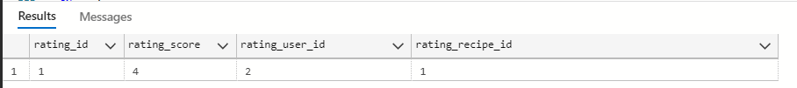
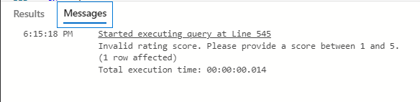
Stored procedure to check whether the provided rating score is valid (between 1 and 5) and then either updates an existing rating or inserts a new one
-- Invalid rating
EXEC sp_add_or_update_rating @UserID = 2, @RecipeID = 1, @RatingScore = 6
SELECT * FROM ratings WHERE rating_user_id = 2 AND rating_recipe_id = 1
Notes:
This executes the stored procedure with an invalid rating score (6). Since the rating score is outside the valid range (1 to 5), it prints a message indicating an invalid rating.
After execution, you can check the ratings table to ensure no changes were made.

Slide 23
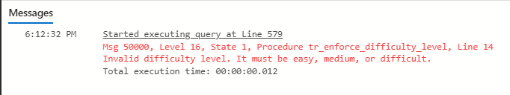
Trigger to ensure that only valid difficulty levels (easy, medium, difficult) are inserted or updated in the recipes table
-- Valid difficulty level
UPDATE recipes SET difficulty_level = 'Easy' WHERE recipe_id = 1
SELECT * FROM recipes WHERE recipe_id = 1
-- Invalid difficulty level
UPDATE recipes SET difficulty_level = 'Hard' WHERE recipe_id = 1
SELECT * FROM recipes WHERE recipe_id = 1
Notes:
This trigger is designed to enforce the constraint that only valid difficulty levels ('Easy', 'Medium', 'Difficult') can be inserted or updated in the recipes table. If an invalid difficulty level is detected, it throws an error.
This updates the difficulty level for recipe 1 to 'Easy,' which is a valid difficulty level.
After execution, you can check the recipes table to see the result.
This attempts to update the difficulty level for recipe 1 to an invalid level ('Hard'). The trigger will throw an error, preventing the update.

Slide 24

USER INTERFACE DESIGN
06.

Slide 25
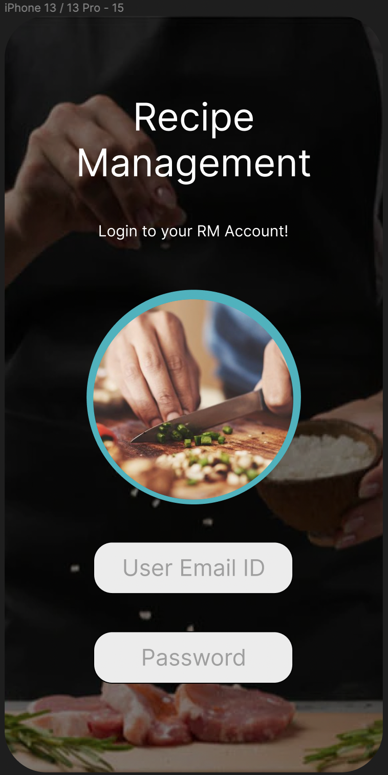
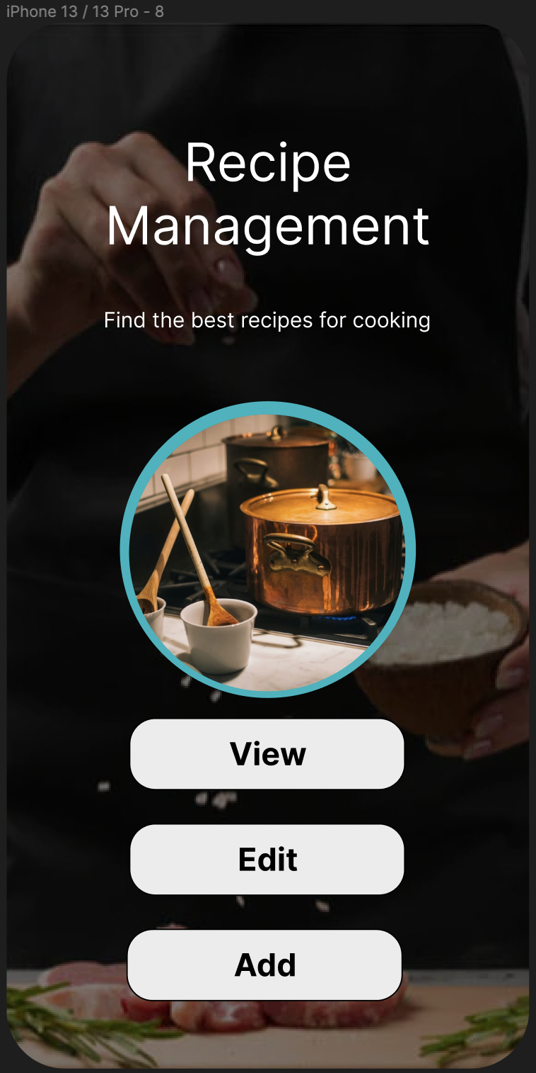

Slide 26
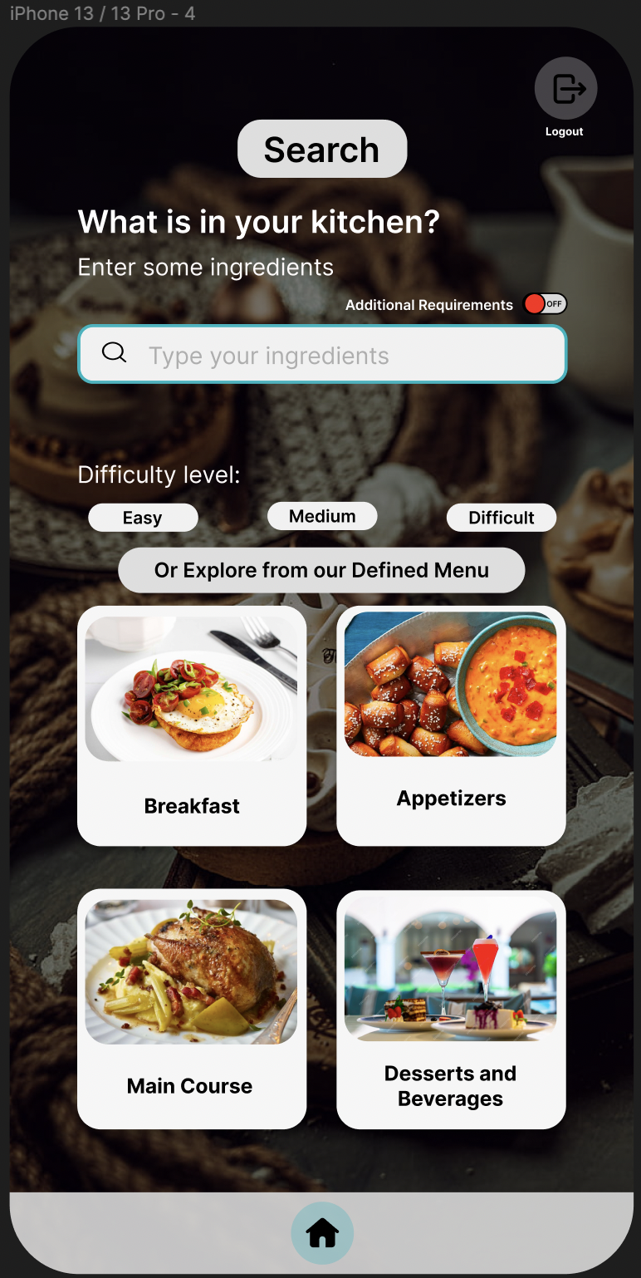
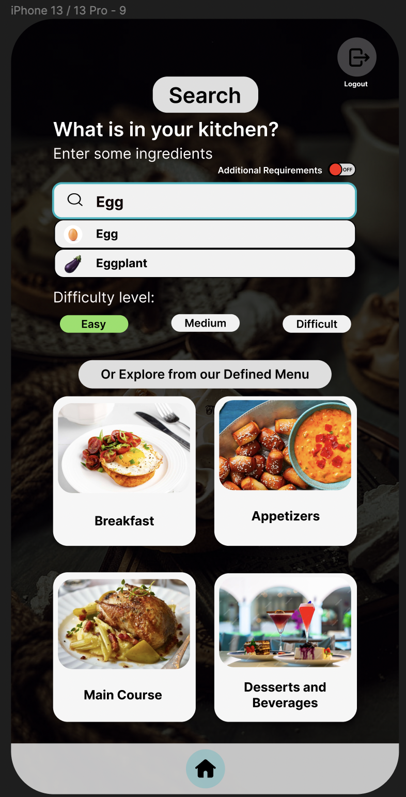

Slide 27
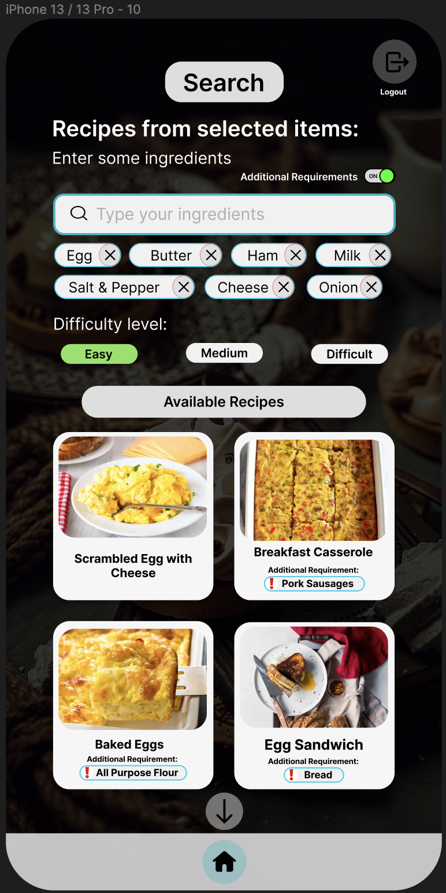
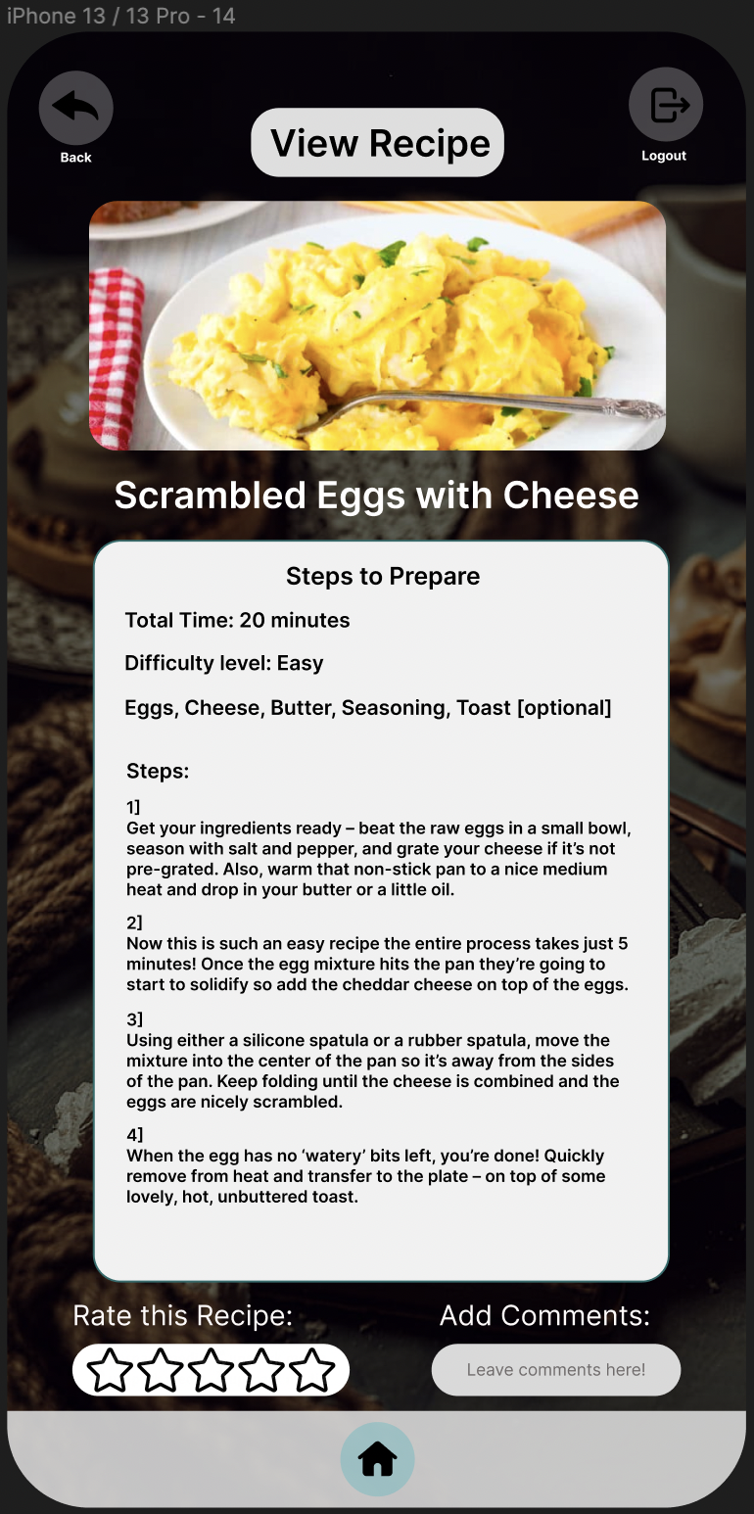

Slide 28
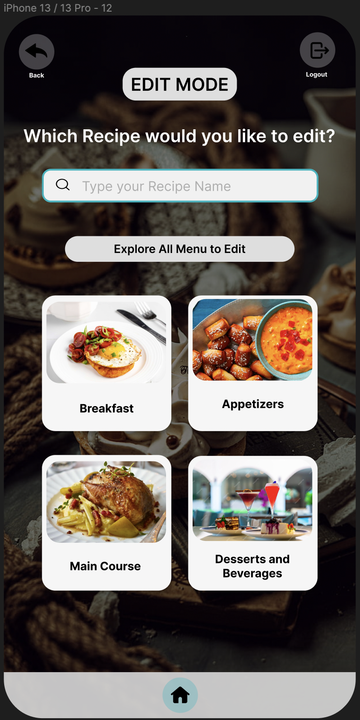
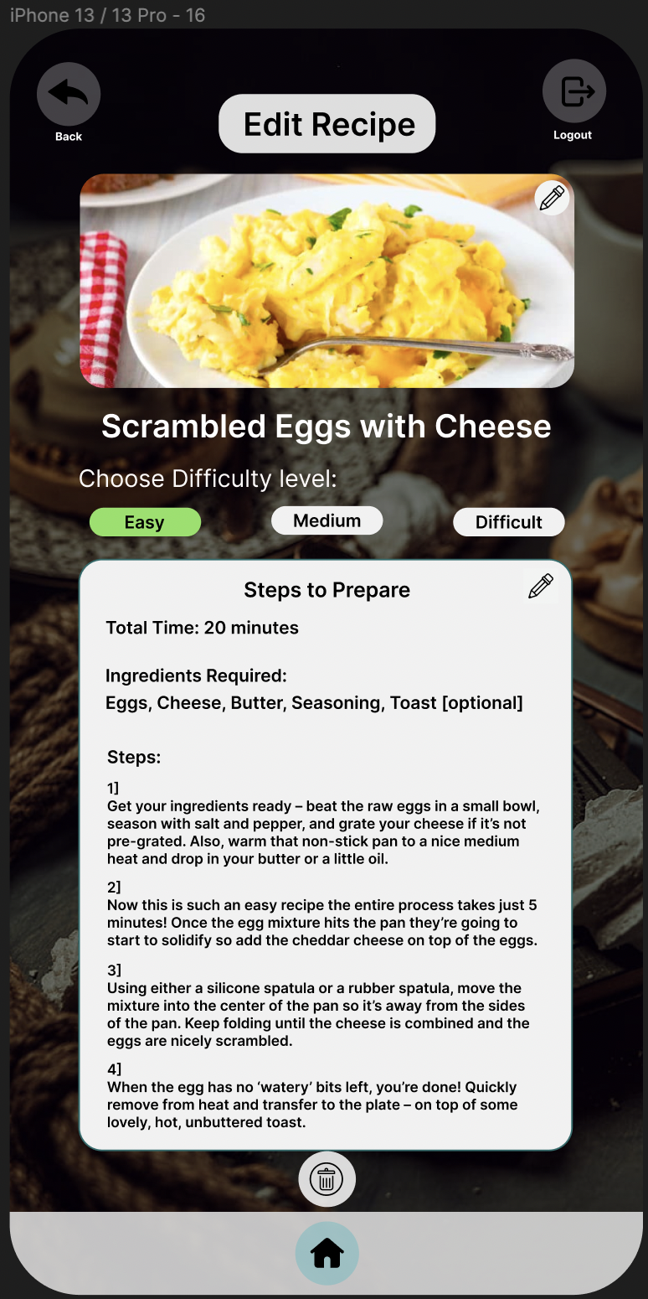

Slide 29
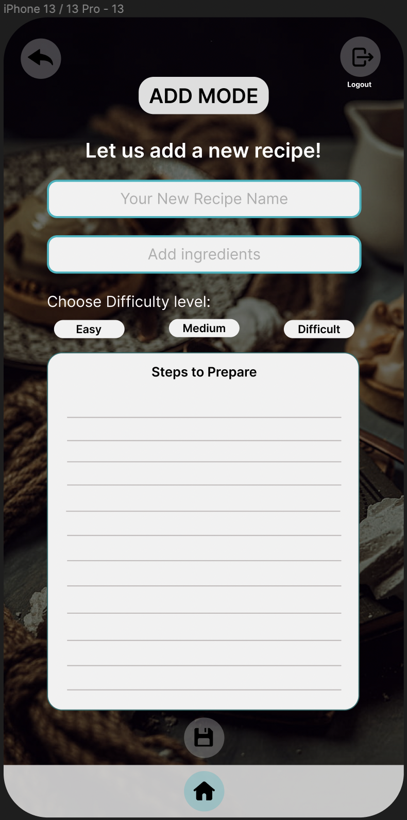

Slide 30

07.
conclusion

Slide 31

Recipe Management System offers a comprehensive and user-friendly platform
From beginners to Culinary Experts
Key Features:
Ability for users to create, modify, and delete recipes, providing a dynamic and personalized culinary experience.
The inclusion of filters for difficulty level, Category and ingredients enhances organization and search capabilities,
allows users to easily navigate and discover new recipes that align with their preferences.
Sense of Community and belonging
The interactive nature of the system, allowing users to rate and comment on recipes, fosters a sense of community and collaboration.

Slide 32

OUR TEAM
Smita deulkar
Atharva nankar
Mrunal nikam
Aakanksha sonawane
sgdeulka@syr.edu
anankar@syr.edu
mnikam@syr.edu
assonawa@syr.edu

Slide 33

Thank You!

